Slide 1
Birth Control Methods **47% of high school teens are sexually active **A sexually active teen who is not using birth control has a 90% chance of pregnancy within 1 year **Teens wait 1 year after having sex before going to a doctor or clinic for birth control

Slide 2
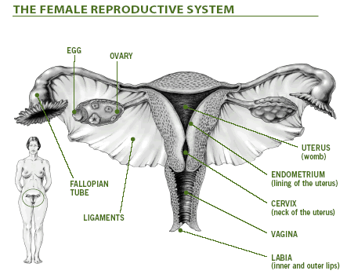

Slide 3
Contraception Methods
Natural
Over The Counter
Barrier
Prescription

Slide 4
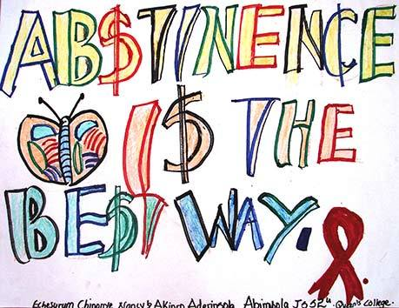
Natural Methods
Abstinence: 100% Effective
What is abstinence?
No sexual contact
“The big 3”
-Oral Sex
-Vaginal Sex
-Anal Sex

Slide 5
Natural methods
Withdrawal- % varies, not an effective method due to the fact that pre-ejaculation contains sperm and STI’s

Slide 6
Over The Counter and Barrier Methods
Male condom (Barrier)- 86%-97%- Latex, plastic, lambskin- lambskin offers no protection against STI’s
Improper storage and “user error” are the major reasons why condoms can fail

Slide 7
Male Condom

Slide 8
FEMALE CONDOM (Barrier)
About 95% effective ……a barrier method
Made of polyurethane (16.5” long) LATEX FREE
One time use
Can be inserted prior to sex
Should not be used together w/ a male condom
Spermicidal or lubricant can be used
Provides protection against HIV & other STI’s

Slide 9
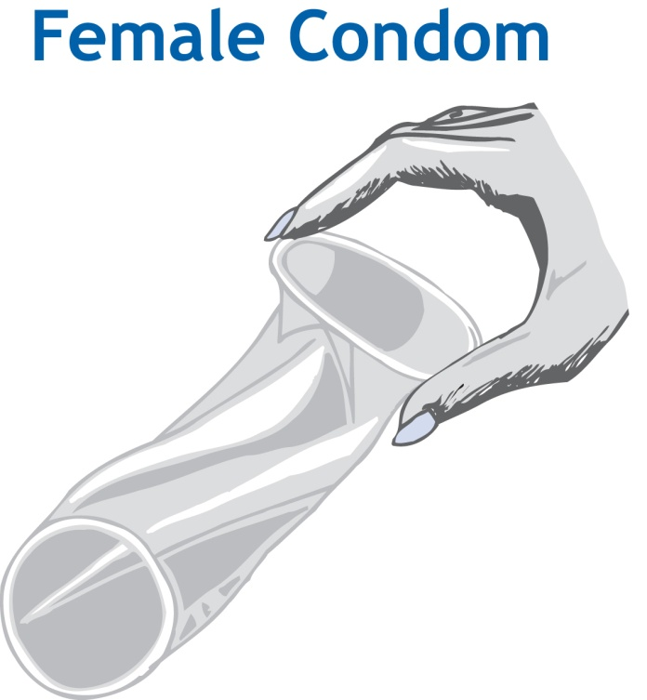
Female Condom

Slide 10
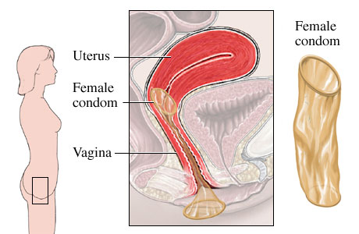
Female Condom Insertion

Slide 11
Prescription Methods
Pill-95-99% effective
2 types: (estrogen/progesterone) or Progesterone (mini-pill)
Need to take pill every day
No prevention of STI’s
Less effective when taking antibiotics-or when experiencing diarrhea, vomiting

Slide 12
The Pill
Low dose of hormones with giving few side effects
If it contains both estrogen & progesterone- thickens mucous around ovaries, fallopian tubes and cervix blocking the release of eggs from ovaries (ovulation)
Minor side effects: nausea, headaches, sore breasts, weight gain, irregular bleeding, depression (usually lessen in 2-3 months)

Slide 13
The Pill
Benefits: regular & lighter periods, less menstrual cramps & PMS, lower risk of ovarian & endometrial cancer, helps w/ acne, enlarged breasts +/- ?????
Users should not smoke
Risks: increase risk of heart disease/high BP/no STI protection

Slide 14
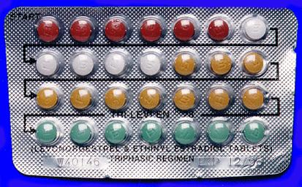
Birth control pills

Slide 15
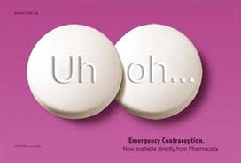
Emergency Contraception\Plan B
75-89% effective
Emergency contraception, not to be used as a daily method/ won’t work if you are already pregnant
Used when unprotected sex has occurred or the pill was not taken properly
2 doses of hormone pills are taken 12 hours apart
Effective up to 72 hours after unprotected sex

Slide 16
Sterilization
99.9% effective
Surgery for men and women
Low reversal rates
Much easier and less invasive when man gets a vasectomy, compared to a woman having a tubal ligation

Slide 17
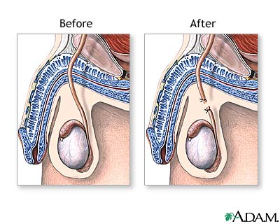

Slide 18
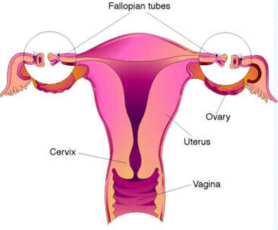

Slide 19
ABSTINENCE IS SO MUCH EASIER AND LESS COMPLICATED THAN ANY OF THOSE METHODS… PLUS IT’S FREE!!!

